Slide 1
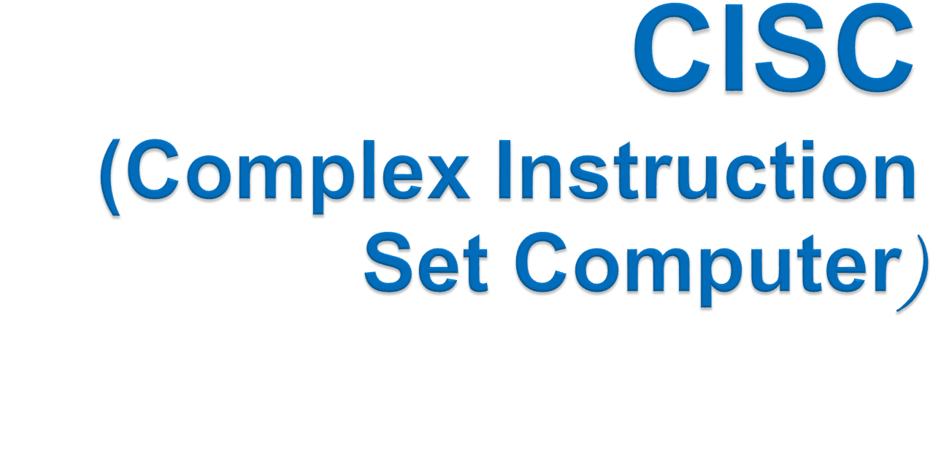
Muhammad Asim

Slide 2

A complex instruction set computer (CISC, pronounced like "sisk") is a microprocessor instruction set architecture (ISA) in which each instruction can execute several low-level operations, such as a load from memory, an arithmetic operation, and a memory store, all in a single instruction.

Slide 3

The philosophy behind it is, that hardware is always faster than software, therefore one should make a powerful instruction set, which provides programmers with assembly instructions to do a lot with short programs.
So the primary goal of the Cisc is to complete a task in few lines of assembly instruction as possible.

Slide 4
Memory in those days was expensive
    bigger program->more storage->more money
Hence needed to reduce the number of instructions per program
Number of instructions are reduced by having multiple operations
within a single instruction
Multiple operations lead to many different kinds of instructions that access memory
  In turn making instruction length variable and fetch-decode execute time unpredictable
  making it more complex
  Thus hardware handles the complexity

Slide 5

Use microcode
Used a simplified microcode instruction set to control the data path logic. This type of implementation is known as a micro programmed implementation.
Build rich instruction sets
Consequences of using a micro programmed design is that designers could build more functionality into each instruction.
Build high-level instruction sets
The logical next step was to build instruction sets which map directly from high-level languages

Slide 6

Register to register, register to memory, and memory to register commands.
Uses Multiple addressing modes .
Variable length instructions where the length often varies according to the addressing mode
Instructions which require multiple clock cycles to execute.

Slide 7

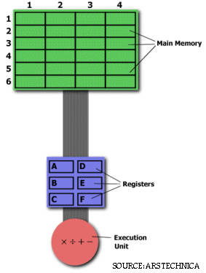
Main memory
Memory (1,1) .. (6,4) = 24 locations
General purpose registers
Registers: A,B,C,D,E,F
Arithmetic Logical Unit
Execution unit : arithmetic ( + -* ÷)

Slide 8

2,3
Let's say we want to find the product of two numbers - one stored in location 2:3 and another stored in location 5:2 - and then store the product back in the location 2:3.
i.e.,
M(2,3)<- M(5,2)*M(2,3)
5,2

Slide 9

For this particular task, a CISC
processor would come prepared with a specific instruction (we'll call it "MULT").
MULT A,B
When executed, this instruction
loads the two values into separate registers,
multiplies the operands in the execution unit, and then
stores the product in the appropriate register.
Thus, the entire task of multiplying two numbers can be completed with one instruction
MULT is what is known as a "complex instruction."
It operates directly on the computer's memory banks and does not require the programmer to explicitly call any loading or storing functions.
It closely resembles a command in a higher level language,identical to
the C statement "a = a * b."

Slide 10

RISC processors only use simple instructions that can be executed within one clock cycle.
The "MULT" command described above could be divided into three separate commands:
LOAD A, 2:3
LOAD B, 5:2
PROD A, B ("PROD“ finds the product of two operands )
STORE 2:3, A ("STORE,“ moves data from a register to the memory banks)
(LOAD, which moves data from the memory bank to a register)

Slide 11

Primary goal is to complete a task in as few lines of assembly as possible
Emphasis on hardware
Includes multi-clock
complex instructions
Memory-to-memory:
"LOAD" and "STORE"
incorporated in instructions
Difficult to apply pipelining.
Small code sizes,
high cycles per second
Primary goal is to speedup individual instruction
Emphasis on software
Single-clock,
reduced instruction only
Register to register:
"LOAD" and "STORE"
are independent instructions
Easy to apply pipelining.
Low cycles per second,
large code sizes

Slide 12


The following equation is commonly used for expressing a computer's performance ability:
RISC
The CISC approach attempts to minimize the number of instructions per program, sacrificing the number of cycles per instruction.
RISC does the opposite, reducing the cycles per instruction at the cost of the number of instructions per program.
cisc

Slide 13

There is still considerable controversy among experts about which architecture is better.
Some say that RISC is cheaper and faster and therefore the architecture of the future.
Others note that by making the hardware simpler, RISC puts a greater burden on the software. Software needs to become more complex. Software developers need to write more lines for the same tasks.

Slide 14

RISC and CISC architectures are becoming more and more alike.
Many of today's RISC chips support just as many instructions as yesterday's CISC chips. The PowerPC 601, for example, supports more instructions than the Pentium. Yet the 601 is considered a RISC chip, while the Pentium is definitely CISC.
Further more today's CISC chips use many techniques formerly associated with RISC chips
So simply said: RISC and CISC are growing to each other

Slide 15



Thank you.

